Slide 1
Nigel Bridgeman
17th March 2023

Slide 2


The project …
Are the inspectors biased?
How can we use ML to determine human behaviour?
I don’t really understand the question but we’ll start anyway ….

Slide 3
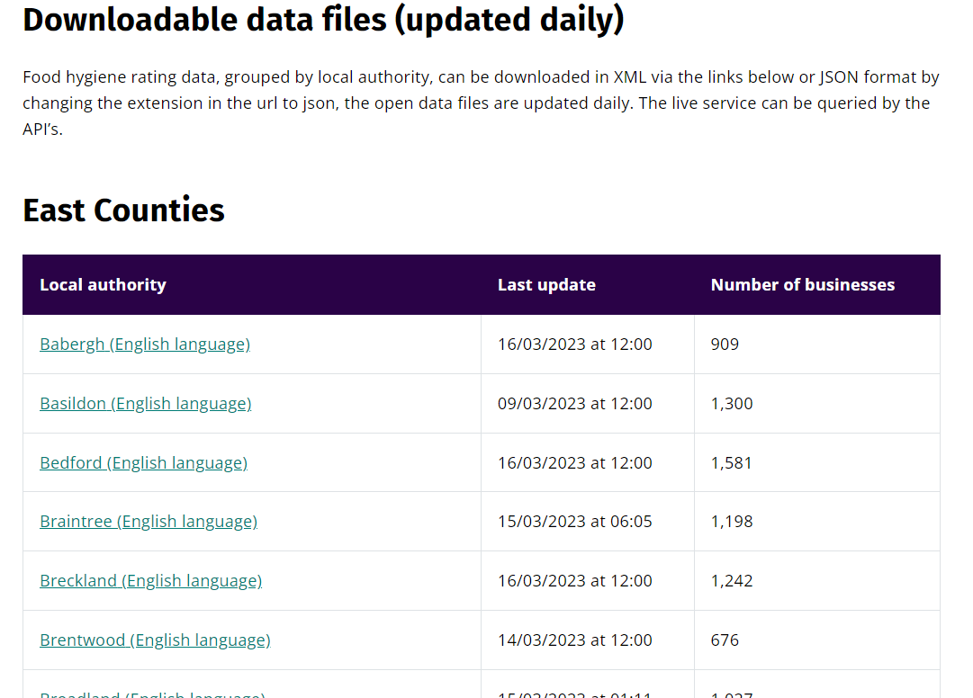
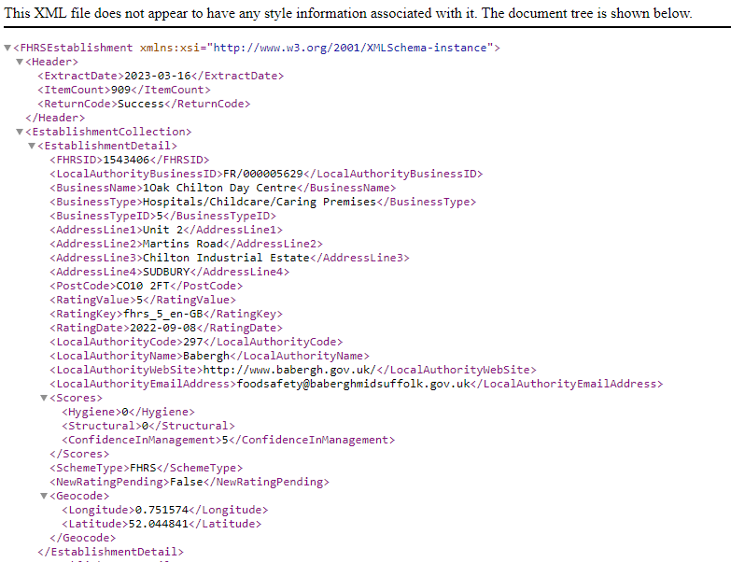
Step 1: Load the Food Rating Data
How:
Beautiful Soup and Selenium to scrape the data
Pre-process to only include Ratings 0-5 and remove all records without a postcode.
Output
CSV file with 490K + ratings

Slide 4
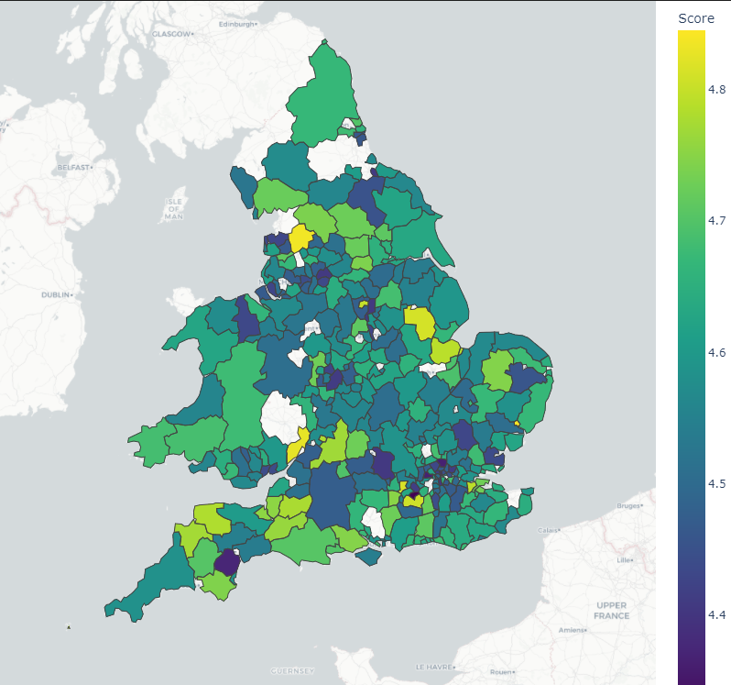
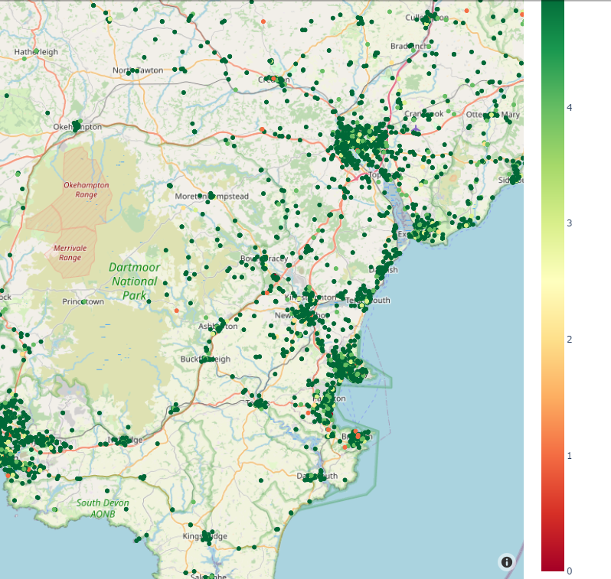
Step 2: Exploratory Data Analysis
How:
‘Nominatim’ to get local authority mapping data
Crosstabs to aggegate the data to local authority level
Plotly express to draw the maps
Output
Food Rating mean varies by Local authority
Localised clustering of food ratings with low values

Slide 5
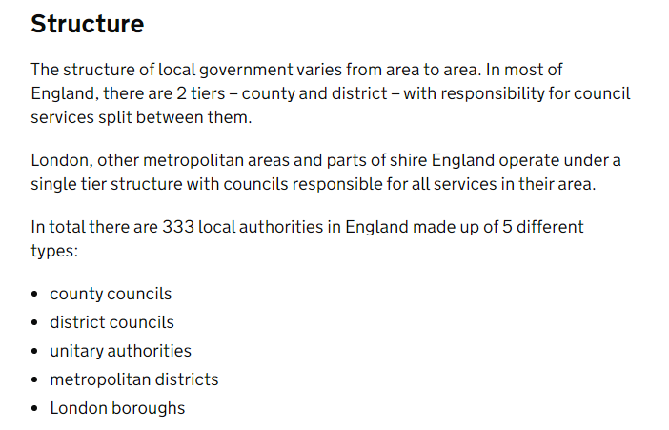
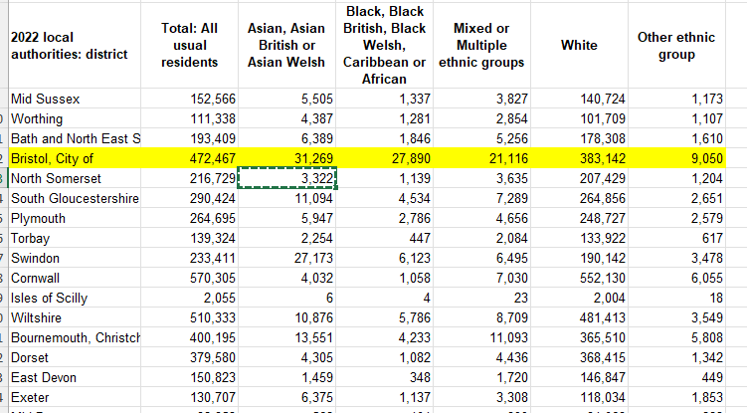
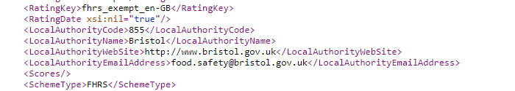
The aborted project – Census data by Local Authority …..

Slide 6

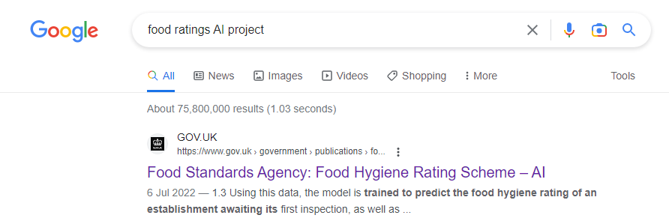
The project
‘Google is your friend, it is not cheating to use it ….’ (Andy Gray)

Slide 7
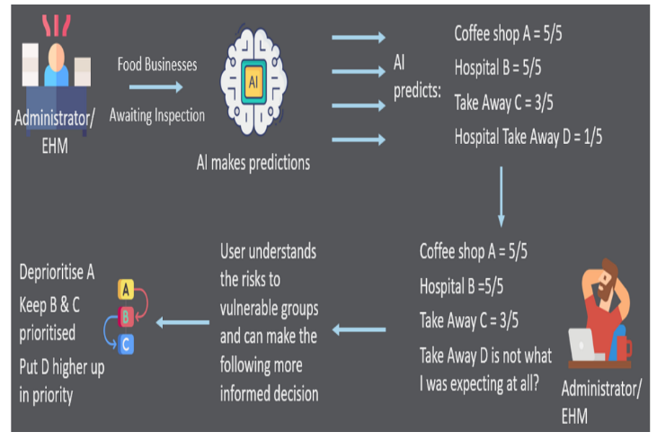
Food Hygiene Rating Scheme – AI
The FHRS AI dataset contains approximately 120 data descriptors. While all of these cannot be detailed, the broad groups that these belong to can be represented as follows: * Business Category and Type (Internal Data) * Business Name and address (Internal Data) * Local Authority Code and Average food hygiene rating (Internal Data) * Demographics of Area (External Data) * Business Size (External Data) * Socio-Economic and Census Details of Area (External Data) * Business Operating Hours (External Data)
The algorithm being used as part of the FHRS AI use case at the FSA is the Light Gradient Boosting Machine (LightGBM) which is a framework for Machine Learning. The LightGBM is based on decision tree algorithms and used for ranking, classification and other machine learning tasks. As part of the use case, the model is used for classifying businesses based on the identified features as being compliant or not and further used for predicting a food hygiene rating (0-5)

Slide 8
The plan …..
Build a simple ML model to ‘mimic’ the FSA concept
Run the model against all existing ratings in England
Compare the Actual Rating v Predicted Rating by Local Authority
Identify Local Authorities with largest deviation from predicted result

Slide 9
Step 3: Expand our data
How:
Postcode to Postcode Sector to Postcode District to Postcode Area (March 2021) Lookup in England and Wales
Ethnic Group Statistics at Postcode Level - Office for National Statistics (ons.gov.uk)
English indices of deprivation 2019 (*a lot of webscraping to get 380+ files)
Panda Group By’s to create Mean Food Rating by Postcode Sector, Area, District
Panda’s to merge it all together
Output:
Original datafile + Ethnic % + Deprivation Index + Food Rating mean by Postcode Sector, Area, District
Demographic
Post Code Sector
White %
Asian %
Mixed %
Black %
Other %
Food Rating
Post Code
Business Type Index
Food Rating Mean by Post Code Sector
Food Rating Mean by Post Code Area
Food Rating Mean by Post Code District
Post Codes
Post Code
Post Code Sector
Post Code Area
Post Code District
Deprivation
Post Code Sector
Deprivation Index
Over 4 million postcodes

Slide 10
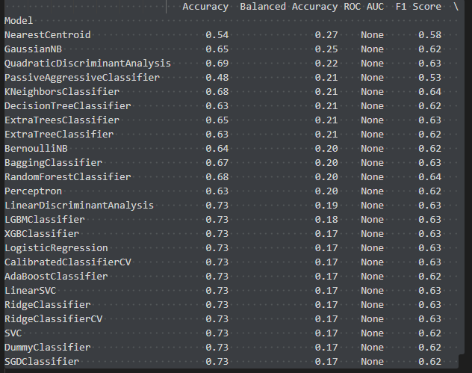
Step 4: Build and Tune our Models
How:
Found a very useful tool called Lazy Learn
Can be run for Classification or Regression
Tools to create parameter matrices
Output:
Models for each of the 3 indicated approaches
Recommended Parameters
Model | Tuning Approach
Decision Tree | Grid Search
KNN | Grid Search
LightGBM | Built in functionality with example from web

Slide 11
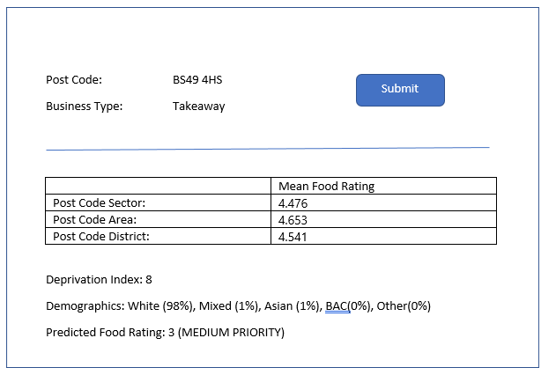
Step 5: Make a tool
How:
User enters PostCode and Business Type
System uses postcode to lookup
Mean Food Rating by Sector, Area, District
Deprivation Index
Demographics
Output:
Predicted Score and Recommendation

Slide 12
Step 6: Run the model against all our data
LocalAuthorityName | Predicted Result | RatingValue | Delta
Sedgemoor | 4.270658683 | 4.889820359 | 0.619161677
Bournemouth, Christchurch and Poole | 4.522133939 | 4.814982974 | 0.292849035
Nottingham City | 4.511431412 | 4.781312127 | 0.269880716
Darlington | 4.567119155 | 4.835595777 | 0.268476621
Torridge | 4.589494163 | 4.856031128 | 0.266536965
Stockton On Tees | 4.637846656 | 4.899673736 | 0.26182708
Redcar and Cleveland | 4.644721907 | 4.835414302 | 0.190692395
Worthing | 4.512820513 | 4.690598291 | 0.177777778
Lancaster City | 4.416853933 | 4.557303371 | 0.140449438
South Holland | 4.728665208 | 4.831509847 | 0.102844639
Hammersmith and Fulham | 4.509634551 | 4.598006645 | 0.088372093
Oadby and Wigston | 4.543396226 | 4.61509434 | 0.071698113
…....................... |  |  | 0
Manchester | 4.947233314 | 4.358528237 | -0.588705077
Enfield | 4.703315881 | 4.10936591 | -0.593949971
Reading | 4.972846442 | 4.371722846 | -0.601123596
Slough | 4.948301329 | 4.339734121 | -0.608567208
South Oxfordshire | 4.956826138 | 4.33722287 | -0.619603267
Birmingham | 4.82945855 | 4.206026308 | -0.623432242
Salford | 4.885892116 | 4.248271093 | -0.637621024
Ealing | 4.77201191 | 4.082943428 | -0.689068481
Wigan | 4.905105725 | 4.206291903 | -0.698813822
Newham | 4.843029638 | 4.14050494 | -0.702524698
Bolton | 4.894162575 | 4.180032733 | -0.714129842
Dudley | 4.892307692 | 4.177718833 | -0.714588859
Waltham Forest | 4.966366366 | 3.83003003 | -1.136336336
How:
Get PostCode and Business Type from original Food Rating File
System uses postcode to lookup
Mean Food Rating by Sector, Area, District
Deprivation Index
Demographics
Output:
Original data + Predicted Score
Lower Ratings than expected
Higher Ratings than expected

Slide 13
Next Steps
Finish optimising the models
Develop the tool in Flask
Consider adding additional census data
Investigate ‘Automatic classification of takeaway food outlet cuisine type using machine (deep) learning’ to automatically classify takeaway food outlets, by 10 major cuisine types, based on business name alone.
Consider unsupervised models to identify clusters of poor ratings rather than calculating the means by postcode sector
Clean up the code and publish on GitHub

Slide 14
Learnings
Use Google earlier!
80%+ of time spend getting data
Issues mapping Local Authority Names (abandoned)
Issues with Post Code formatting
Maps are easy and rewarding
Key to the ML model is understanding the metrics available
Get familiar with the hyperparamer tuning (Grid CSV)

